Slide 1
Method of Joints
Dr. Jacob Moore
Associate Professor of Engineering
Penn State Mont Alto

Slide 2
What Are We Looking For?
In the method of joints (and the method of sections and analysis of frames and machines for that matter), we are trying to determine the forces acting on each individual member in the structure.
If each member is a two-force member, we need to find the magnitude of the force and whether the member is in tension or compression.

Slide 3
The Method of Joints
The method of joints works on the following assumptions:
The structure you are analyzing is in static equilibrium.
The members in the truss are connected to one another with pin joints (which can exert forces but not moments),
The pin in each pin joint is also in static equilibrium.
Each member connected to a pin will either push or pull on these pins along a known direction (the line of action between the two connection points on the member).

Slide 4
Method of Joints
Step 1: Label all the joints (if they are not already labeled)
(applies to method of joints and method of sections.)
10 m
10 m
B
5 m
A
C
D
F = 6 kN

Slide 5
Method of Joints
Step 2: Treat the whole truss structure as a rigid body and solve for the external reaction forces
(applies to method of joint and method of sections.)
Use sum of forces in the x equal zero, sum of forces in the y equals zero and sum of the moments equals zero.
10 m
10 m
B
5 m
F_{R1Y}
F_{R2Y}
A
F_{R1X}
C
D
F = 6 kN

Slide 6
Method of Joints
Step 3: Separate the truss into the individual joints and members.
Step 4: Draw in all the forces each member exerts on the pin, creating a free body diagram for each of the joints.
Assume tension in the direction of the member.
Ignore the members themselves.
B
F_{AB}
F_{BD}
F_{BC}
3 kN
3 kN
F_{AB}
F_{BC}
F_{BD}
F_{AC}
F_{AC}
F_{CD}
F_{CD}
A
C
D
6 kN

Slide 7
Method of Joints
Step 5: Write out the equilibrium equations for each of the joints using the free body diagrams you created.
You will only have force equations, no moment equations, so you will have two possible equations per joint.
Step 6: Start solving the equations
Start at a joint with only two unknowns, then work out from there
Positive results indicate tension in the member
Negative results indicate compression in the members (since we assumed tension)
B
3 kN
F_{AB}
F_{BD}
3 kN
F_{BC}
F_{BC}
F_{AB}
F_{BD}
F_{AC}
F_{AC}
F_{CD}
F_{CD}
A
C
D
6 kN

Slide 8
Method of Joints for Space Trusses
Analyze the truss as 3-dimensional rigid body to find the reaction forces supporting the truss. (sometimes optional)
Start at a joint with 3 or fewer unknown forces and draw a free body diagram of the joint.
Assume all unknown forces to be tension forces.
Write out the equilibrium equations for that joint (forces in the x, y, and z).
Remember you can use angles or the ratio method to find components of 3D force vectors.
Solve the equilibrium equations for the unknowns.

Slide 9
Thanks for Watching
See other engineering mechanics videos and access the full tool at…

Slide 10
Method of Joints Worked Example
Use the method of joints to find the forces in all members of the truss shown below. Remember to specify tension or compression.
80 kN
60 kN
10 m
10 m
10 m
Y
A
B
D
F
X
20°
C
E

Slide 11
Method of Joints Worked Example
Use the method of joints to find the forces in all members of the truss shown below. Remember to specify tension or compression.
6 ft
6 ft
6 ft
Y
6 ft
500 lbs
X

Slide 12
Method of Joints Worked Example
1 m
1 m
1 m
Use the method of joints to find the forces in all members of the truss shown to the right. Remember to specify tension or compression.
.6 m
2 m
6 kN
Y
X

Slide 13
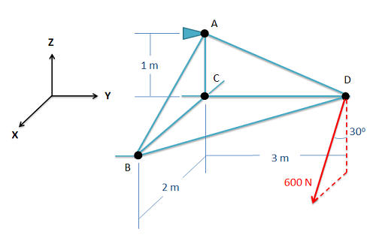
Method of Joints Worked Example
Use the method of joints to find the forces in all members of the truss shown to the right. Remember to specify tension or compression.

Slide 14
Method of Joints Worked Example
Use the method of joints to find the forces in all members of the truss shown to the right. Remember to specify tension or compression.
z
B
4 m
A
2 kN
C
y
4 m
E
D
2 m
x
2 m

